Slide 1
Complex Screen Controls
IN721 2019
Design and Development for Mobile Devices
Session 2.2

Slide 2
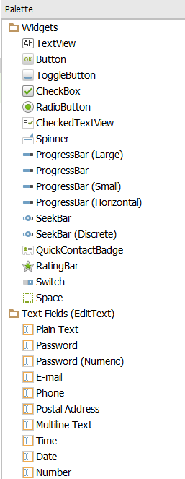
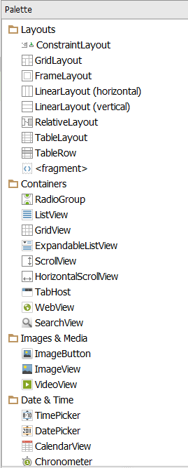
More Widgets (Screen Controls)
Notes:
Note that we are talking here about members of android.widget. That is, screen controls you put on your layout and write code for.
There is another use of the term widget, which we will address later on.
For now though: screen controls with methods, properties and events.
We have worked now with buttons and textViews and EditText controls.
There are many, many more useful screen controls available in Android. Fortunately, as members of the same OO family, their programmatic behaviour is consistent. If you’ve mastered the first three you will be able to extend your understanding to the others fairly painlessly.
The most common workflow for screen building is drag and drop from the Tool Palette.
The controls are organised into categories in vertical tabs as shown.
You can drag controls either onto the screen image (and use the grid lines) or onto the Component Tree.
In either case, the system will automatically generate the xml for you in the layout file (/res/layout/activity.xml)
Alternatively, you can edit the xml directly. This is often easier when you are duplicating a control (e.g. making a grid of image controls) and can benefit from cut and paste.
The Android control classes provide the usual range of user events -- mouse actions, text changes, selection, etc. -- that you can write handlers for.

Slide 3
Layout Controls
Non-visual controls, which apply spatial rules to the widgets they contain.
LinearLayout:
Contained controls arranged as in a list
Horizontal or vertical
RelativeLayout
Contained controls placed freely.
Positioned “in relation to” each other
Notes:
Special controls: Layouts
Groups of associated controls are placed in instances of the layout class, which are not themselves visible, but provide various features arrangement of the controls they contain (like a <div> in HTML/CSS).
“In relation to” here means things like “46 pixels below this guy” and “16 pixels to the left of that guy”
There are also the frame and grid layouts. Less common. See docs.

Slide 4
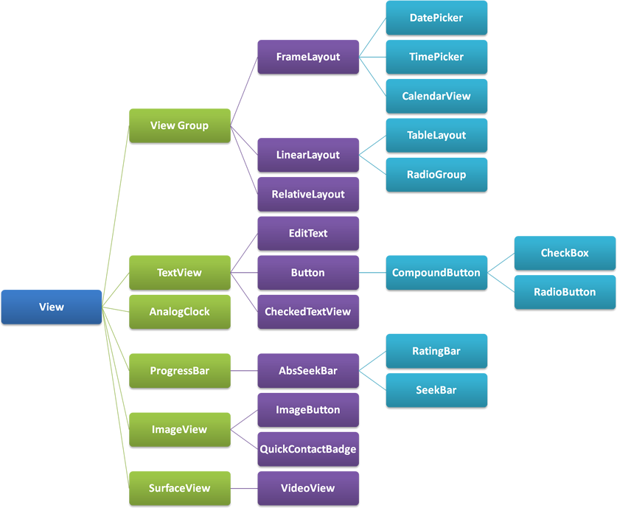
View Class
www.itcsolutions.eu
Notes:
All controls are members of the class hierarchy View.
Here is the complete hierarchy.
All the usual suspects.
Each has particular features/method.
For example, the ProgressBar exposes incrementProgressBy(int diff)
When you need a particular control, get into the documentation and find out how to use it.
As an example, let’s look today more closely at EditText…

Slide 5
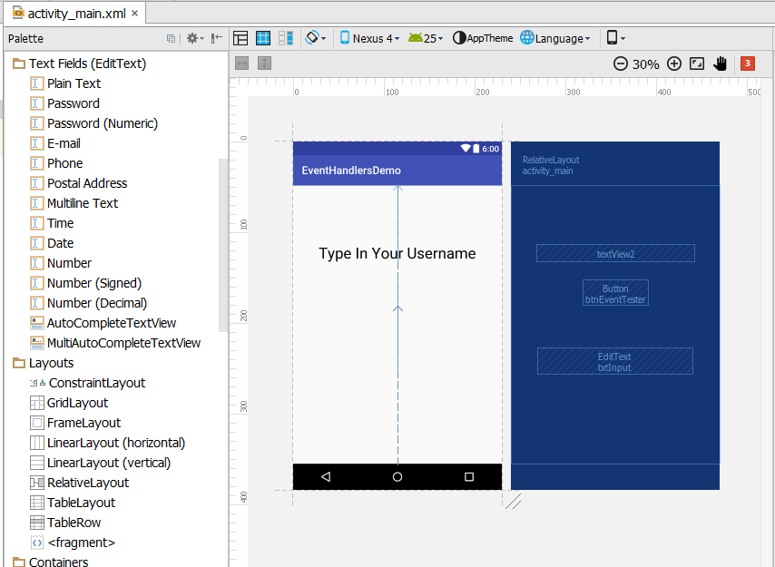
EditText (android.widget.EditText)
Notes:
We’ve looked at EditText a little already in the last practical.
Let’s look more closely at some of its attributes.
We saw last week that the Text Fields tab offers a number of versions of EditText, differing in the value of their inputType attribute.
Further, when we drag and drop one onto the screen, the appropriate XML is generated in the layout file

Slide 6
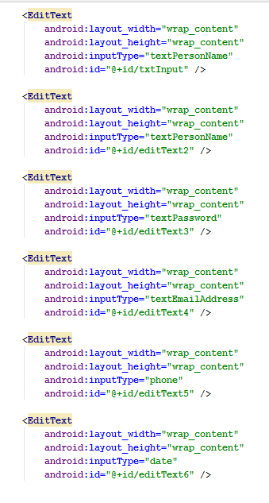
EditText (android.widget.EditText)
Notes:
Here is your default XML, with some of the positioning attributes removed to fit all this on the screen.
Note the android:inputType attribute values
(We will talk about the others in a minute.)
If android:inputType is not defined, it is a plain text field, as discussed in last week’s practical
For the other input types, the appropriate soft keyboard will be presented and/or the appropriate display style (e.g. for passwords) will be used.
Just by magic.
EditText controls have a lot of other attributes. For example, you can also do things like configuring AutoComplete. See http://developer.android.com/guide/topics/ui/controls/text.html for full details.\

Slide 7
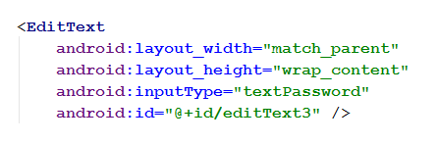
Attribute Values
Notes:
Let’s take a closer look at some XML…
This is the definition of a typical sort of EditText.
We have discussed the id and inputType attributes previously
Look at the other attributes:
Android:layout_width = “match_parent”
Android:layout_height = “wrap_content”
In this example, they have been assigned system constants as values. We have also seen some other options...

Slide 8
Setting android:layout_width
match_parent | Make the same width as the containing control
wrap_content | Make as wide as needed to contain the content
“25dp” | Make the control 25 screen pixels wide
@dimen/some_resource | Set the width to the value of this resource constant.
Notes:
In this case, “match-parent” means “make this control as wide as its parent”
And “wrap content” means “make this control as high as its content.
Both of these assume adjustment for padding, which is the space between content and boundary.
There are a variety of possible units other than dp (see docs), and the value can be any floating point number.
There are lots of other layoutish properties that you can configure to control how your controls size themselves….

Slide 9
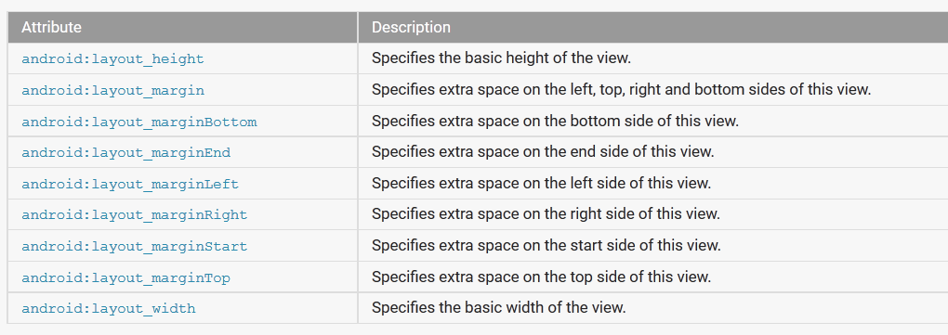
More View Attributes…
developer.android.com/reference/android/R.styleable.html#ViewGroup_Layout
Notes:
Do we need to go over each and every one of these? → No, because this is 3rd year.
See the docs.

Slide 10
To-Do (outside of class)
Figure out android:layout_weight
Notes:
android:layout_weight is a very important positional property (it is, for example, how you control column widths and centering).
It is also deeply weird.
As an exercise, figure it out.
Remember, this is how jobs work.

Slide 11
Complex Controls
<Radio Group>
Contains a set of <RadioButton> elements
Implements expected mutually exclusive click behaviour.
Useful events:
OnClick event of individual buttons
OnCheckedChanged event of containing RadioGroup
Notes:
There a lots of other controls you will want to experiment with.
For example.

Slide 12
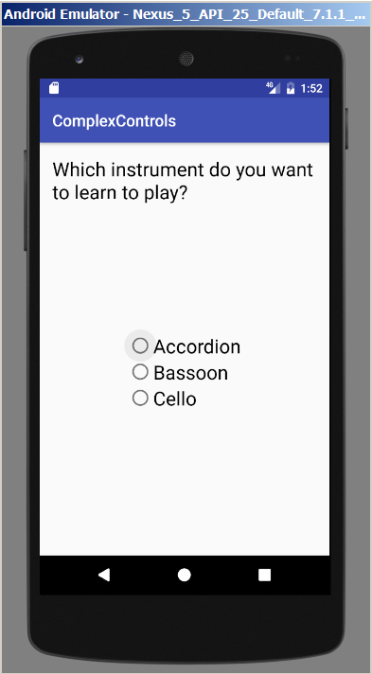
RadioGroup and RadioButton
Notes:
RadioButtons are checkable toggles as you would expect
To define a mutually exclusive set of radio buttons, nest them in a RadioGroup control.
This is one of the actions that I find easier to do by dragging to the Component Pane.
Change the text of the buttons and the ids (of course) in the Properties window, or in the XML, whichever you prefer
Same with text size.
Either way, it will look like this..

Slide 13
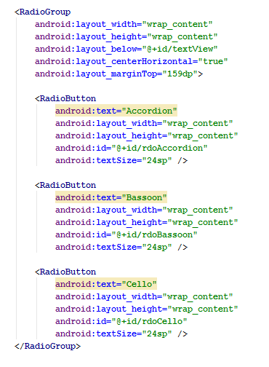
RadioGroup and RadioButton
Notes:
Note the sensible ids.
Makes your code easier to read
The yellow highlighting is AS being upset about the string literals.
How would you fix that? → add <string> elements to /res/strings.xml and access them here with @

Slide 14
RadioGroup Events
Interface | RadioGroup.OnCheckedChangedListener
Associated Interface Method | void onCheckedChanged (RadioGroup rg, int checkedID)
Event setter method of the RadioGroup control | setOnCheckedChangedListener
Notes:
As an example, we’ll make some code run whenever someone clicks on one of the buttons.
As always, we need these three elements to wire up an event – the interface, the interface method and the event setter method of the control
Here is one option...
What is the procedure? → Write an inner class that implements the interface; write code for the method; bind in onCreate.
Let’s look at some code...

Slide 15
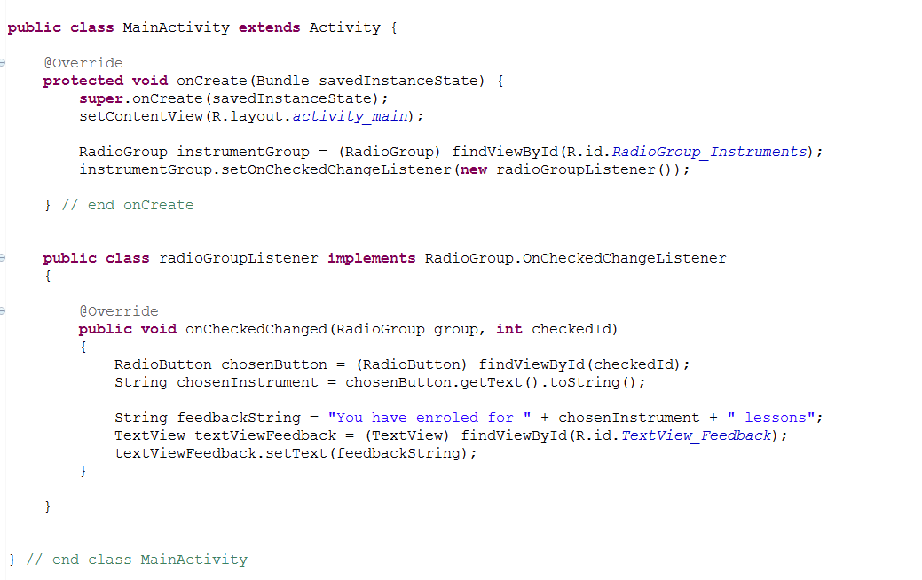
RadioGroup and RadioButton
Notes:
Walk through…
See how the system passes the id into onCheckedChanged? And we use it in findViewById?
Each of these system event methods gets different stuff, presumably everything you need to do what needs done. We will look at many examples.

Slide 16
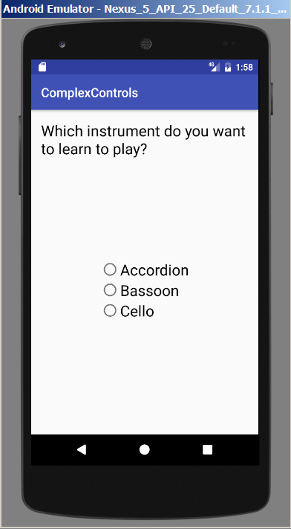
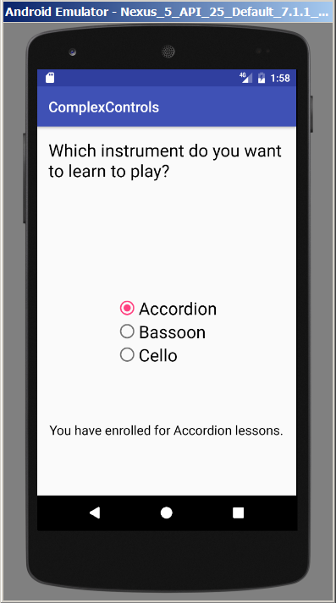
RadioGroup and RadioButton
Notes:
And there are lots of other events for these controls.
Approach them all the same way
Use the documentation for details.

Slide 17
A User Interface Issue
Notes:
So the feedback appears on selection.
Is that good or bad, from an interface design perspective?
Maybe a little bad, if clicking on this button actually enrols them in a class. Perhaps an opportunity to confirm would have been better.
How would you implement that?
Add a button
On click, figure out which radio button was checked.
Useful hint: RadioGroup.getCheckedRadioButtonId();
Take some action based on that.
Putting controls on a screen is easy. Making them do stuff is easy.
Putting the right controls, and making them do the right stuff – is hard.

Slide 18
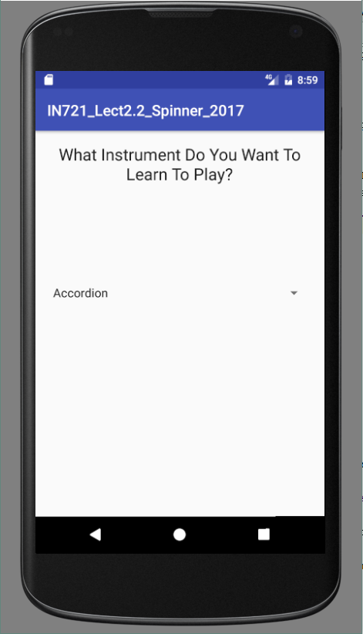
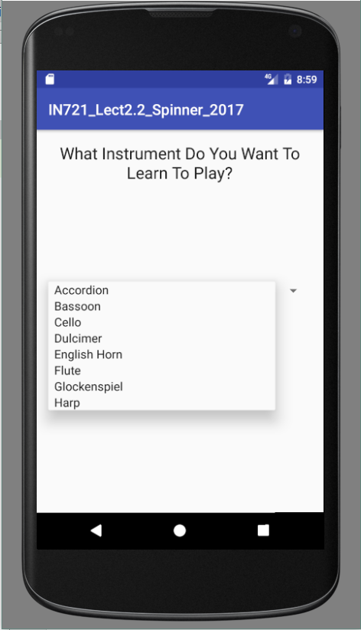
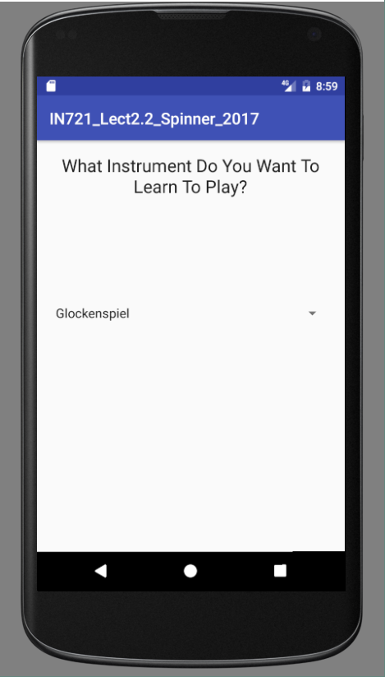
Spinners
Notes:
And there are lots of other controls.
Some are easy to use, some are more complicated.
Here’s one of the complicated ones.
The spinner is for drop-down menus. Useful when you have too many items for radio buttons (6 is considered a maximum), or are really low on space.
NB: It is possible to make your spinner offer an empty default, but it requires a little more code – you have to override a one of the class methods. See docs for details.
The spinner is one of a set of controls that contains complex data – i.e. more than one item, what we think of as a list of elements.
Populating these controls requires more effort than just typing something into the properties window.
In fact, it’s pretty tricky
Let’s look...

Slide 19
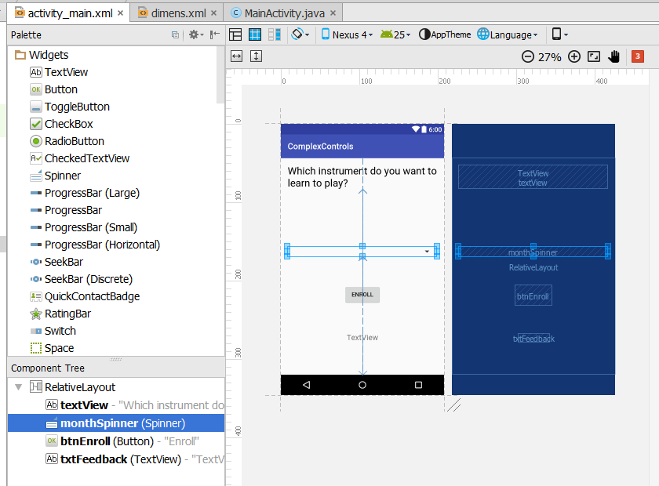
Spinners
Notes:
We can drop the control in Design View, and we will get XML….

Slide 20
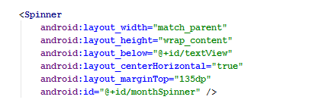
Spinners
Notes:
…we will get XML, but there’s nothing in it yet.
We need to put the contents in by creating a data structure to hold the values and binding that data structure to the spinner.
To do this, we will need to use yet another of the Android classes...

Slide 21
Controls with Complex Data
For controls that support a list of values:
Create the list of values as an array.
Bind the array to the control.
Data binding requires an Adapter.
Adapter is an Android class that exposes methods to bind arrays to controls.
Notes:
Meet the Adapter class
You can think of the Adapter as being able to load the control up with the contents of the list.

Slide 22
Binding with an Adapter
Define the array of items.
Get a reference to the control.
Create the Adapter, passing into its constructor:
The current activity.
A TextView layout to format the list items when displayed.
The array.
Call the control’s setAdapter method, passing in the Adapter.
Notes:
It sounds complicated, but the code is actually quite simple.
The newest one for us is the “TextView layout” part.
We will look at each of these steps in turn

Slide 23
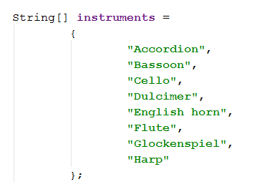
Binding with an Adapter
Define the array of items
Notes:
You can define it in the code like this, a normal Java array, or
You could also make this a string-array resource

Slide 24
Binding with an Adapter
Get a reference to the control
Notes:
This one you know how to do.
Say that I have dropped a spinner onto the layout like in the earlier image, and I have changed its id to instrumentSpinner

Slide 25
Binding with an Adapter
Create the Adapter, passing in:
The current activity
A TextView layout to format the list items when displayed.
The array
Notes:
“Create the adapter” of course means “call its constructor”
The current Activity, as we know, is this, or ActivityName.this if inside an event handler class.
We’ve made the array, that String[] a couple of slides ago.
So what is this layout?
It is just all those XML attributes you get when you drag and drop a TextView onto your screen.
You could make your own. Just make an XML file in /res/layout, put in a <TextView> with the attributes you want, and refer to it here as you do all other resources.
However, if you want “android-style”, consider using some of the android predefined layouts.
Here’s an example....

Slide 26
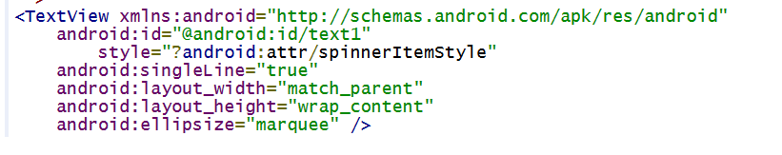
Using a System Layout
Notes:
What do you think this is? It looks like a reference to a resource in R, as we have frequently used.
By note that we always just say “R.xxx.yyy” and this says “android.R.xxx.yyy
There are two R classes floating around. One is the R the system creates in your application. But this one is android’s own class R.
They are in different namespaces/packages, so the system doesn’t get confused.
Here is the simple_spinner_item TextView
As advertised – simple.
So using a system layout is logically equivalent to using some pre-written CSS. It just defines a few style properties.
What do you think android.R.layout.simple_spinner_item is? => It is a resource id, which is actually what we need to create that adapter.
Let’s grab it in our code, like this...

Slide 27
Binding with an Adapter
Create the adapter, passing in:
The current activity
(The resource ID of) a TextView layout to format the list items when displayed.
The array
Notes:
Back to this.
Now that we know all the bits an pieces, let’s create an adapater.
Since we are binding an array of strings, we’ll use an ArrayAdapter for String. (ArrayAdapter<String>)
Here’s all the code...
Remember that instruments is the String[] we made earlier

Slide 28
Binding with an Adapter
Call the control’s setAdapter method, passing in the Adapter.
Notes:
And finally.....
Putting it all together...

Slide 29
Binding with an Adapter
Define the array of items
Get a reference to the control
Create the adapter, passing in:
The current activity
A resource ID for the TextView layout for the list items when displayed
The array
Call the control’s setAdapter method, passing in the Adapter.

Slide 30
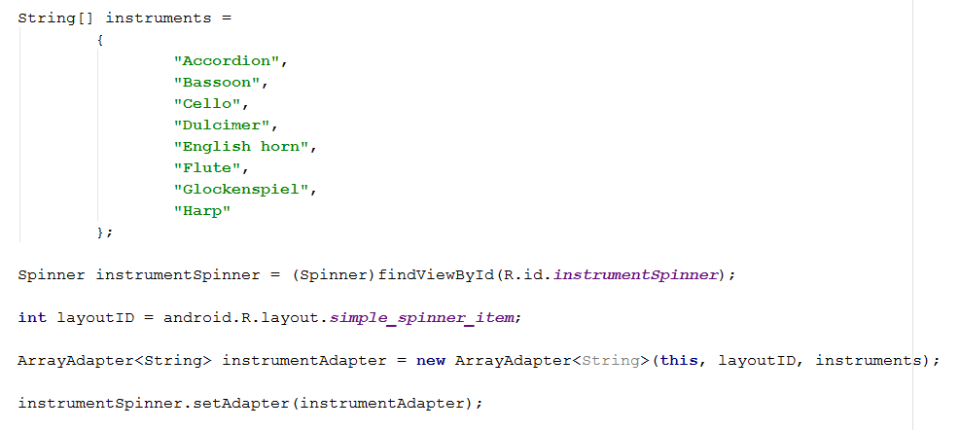
Binding with an Adapter
Notes:
Get that into your onCreate (consider writing a method, please) and you’ll have your awesome spinner.
It’s not a lot of code, but it’s very specific, dictated by the architecture of the Android classes.
You have to do it this way.
You have to learn that you have to do it this way.
What’s the best way to learn these things?...

Slide 31
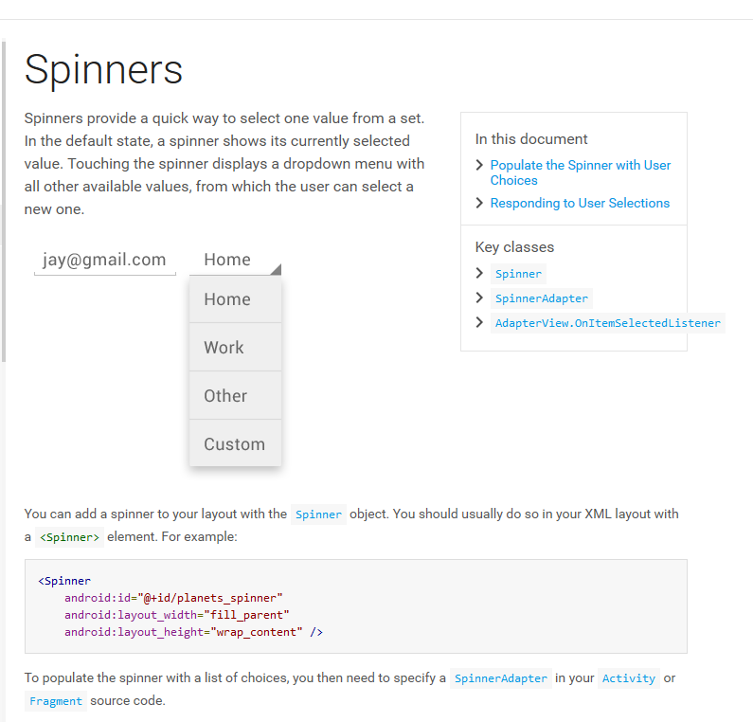
developer.android.com
Notes:
Read the docs.
Copy and paste from stackoverflow may seem faster, but you don’t really learn the underlying logic that way, so, the next time you want to do something, you won’t be able to figure it out.
You’ll have to do some more robo-coding.
Not only is this inefficient, but it puts a very low ceiling on what you will be able to do.
Never use code that you don’t understand.
Never ever.

Slide 32
Spinner Behaviours
Read data from the spinner with:
Object getSelectedItem()
int getSelectedItemPosition()
Respond to a selection event with
Interface | OnItemSelectedListener
Interface Method | onItemSelected
Event setter method of the Spinner | setOnItemSelectedListener
Notes:
What can you do with a spinner?
Some handy methods (there are lots more; see docs).
Note that getSelectedItem returns an object, not a string, so you will need to cast.
Why do you think the system returns an object? => Because your spinners can hold more complicated things. They are not restricted to string. They could, for example, hold user-defined class instances. This would allow you to pass lots of information around in the spinner.
We will do this later when we want to get some images into our spinners.
There is that event handler pattern again. For fun, see if you can pop up a toast that displays the selected instrument...

Slide 33
Are there more?
Check box
Progress bars
Rating bars
Switch
Lists
Image button
Gallery
Date picker
Chronometer
Media switchers
Media flippers
Analogue clock
Calendar
Color picker
....
Notes:
You bet.
These are all available from the palette. (And there are still more....)
Each of these is a class with methods and properties.
Some are complex, some are simple
Are we going to discuss all of them in detail? => No.
For each, you will need to get into the docs, find out what methods are exposed, find out what events are supported, find out the syntax of each.
The process is just what we have gone through for TextView, RadioGroup and Spinner.
NB: Since these are all classes, if you want to you can descend from them and customize them. Out of scope for us, but see docs if you’re keen.

Slide 34
Docs
http://developer.android.com/guide/topics/ui/index.html
Notes:
These are all very complex controls with dozens of properties each with legal property values and so on.
You’re not going to memorise them all.
Get comfortable with the docs.
These talk about both the technical issues and user interface of Android-style.

Slide 35
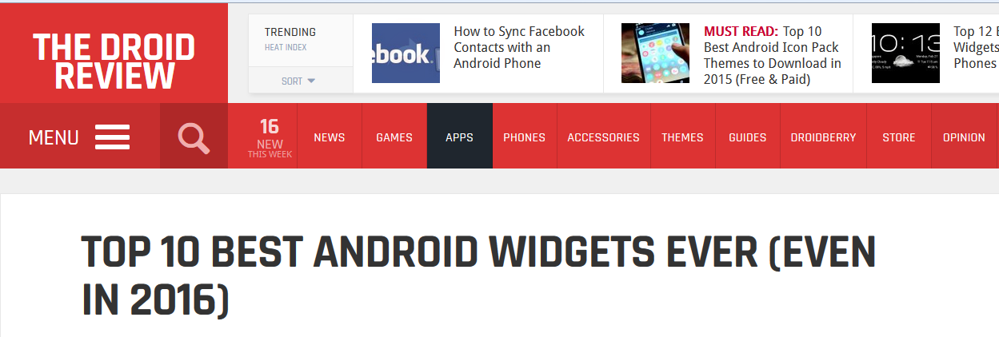
App Widgets
“App Widgets are miniature application views that can be embedded in other applications (such as the Home screen) and receive periodic updates.”
developer.android.com/guide/topics/appwidgets/index.html
Notes:
Just for clarity: there’s a little terminology overlap here
From a technical programming perspective, we think of “widget” as a member of the android.widget class hierarchy. We are talking here about “screen controls”.
There are also these little guys: App Widgets
They are little applications, but the user doesn’t launch them, they just sit around being live and usually displaying data and periodically updating themselves.
Useful for things like stock tickers, weather forecasters, etc.
So when Time Magazine says this, they are, sadly, not talking about super cool programmable things you can use as a developer, they are talking about little utilities that other people have written that you can download onto your phone.

Slide 36
Practical
Working with complex controls

